Slide 1
Azure Synapse Analytics
By using Airlines data

Slide 2
Problem Statement – Use Case
Understand the Airlines data
Process the Airlines data using Azure Synapse Tool
Analyse the Airlines data to produce meaningful insights and create visualisations in the PowerBI tool
Implement using Spark Pool (python)

Slide 3
Big Data vs Traditional data
Traditional data
Centralized database architecture
Structured data
Big Data
Distributed architecture
Computation distributed across several computers
Scalable and better performance
Volume is around Gigabytes to Terabytes
Data is generated per day or per hour basis
Large datasets comprising of structured, semi-structured and unstructured data
Volume is in Petabytes to Zetta and Exabytes
Size is small
Size is very huge
Data is generate every second
Data model is strict schema based
Data model is dynamic and flat schema
Easy to manage and manipulate data
Difficult to manage and manipulate data

Slide 4
Action Plan and Approach
Airlines data is updated every hour
Solution to handle the large volume and variety of data
Big data solutions are the way to go
Charts and Metrics to be refreshed every minute for Flights Status within an Airport
Plan is to use Azure Synapse Analytics by implementing this solution using Spark Pool

Slide 5
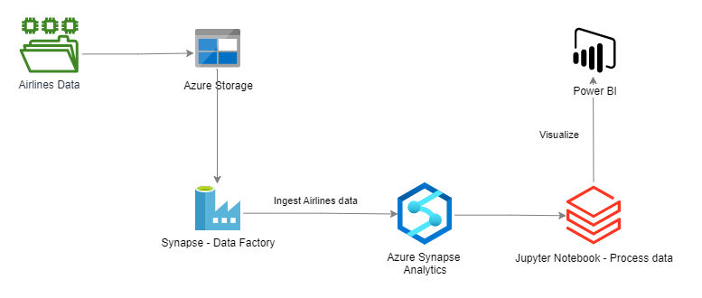
Solution Architecture – Spark Pool

Slide 6
Dedicated SQL Pool vs Serverless Pool vs Spark Pool
Dedicated SQL Pool
Formerly known as Azure SQL DW
Provides Compute and Storage
Serverless Pool
Provides only Compute, there is no Storage
Cannot access data in Dedicated SQL Pool
Storage space is provided by Azure Storage so it can scale independently from the compute cluster
You will not be charged for compute when it is paused but have to pay for Storage
DWU sets the amount of CPU, memory and I/O used by the cluster
Generally used to query data in other places such as
Spark Pool
Lets you use Spark to query the structured and un-structured data
You can pause the SQL Pool
CSV, Parquet and JSON files available in Azure Storage
External tables in Azure Storage created by Spark Pools
You only have to pay for the amount of data processed by your queries
Automatically created by Azure Synapse Workspace
Depending on the need, it can auto-scale by removing and adding nodes
Supports multiple languages like C#, Scala, PySpark, Python and Spark SQL
Mainly used for processing your data stored in Azure (Delta lake)
Provides in-memory cluster computing
Billing is prorated per minute, whether you are using or not. Shutdown the Spark instance after you have finished using it

Slide 7
Practical Lab – Apache Spark Pool
Practical Implementation using Azure Synapse – Apache Spark Pool and visualisation using Power BI

